Slide 1
Challenges Faced by SMEs in Using the IP System in their Competitive Strategies
Gabriele Gagliani
Beirut– 27-28 March 2018
WIPO Sub-Regional Workshop on Policy Mechanism for Supporting Small and Medium-sized Enterprises Use of the Intellectual Property System in Their Competitive Strategy

Slide 2
Content and Objectives
Challenges for SMEs in using the IP system
&
some possible solutions

Slide 3

An Overview of the Challenges
Three general challenges/problems:
Lack of information on intellectual property
Lack of “time”: SMEs do not know why they should “lose time” with IP
Lack of understanding: SMEs do not understand why IP is relevant

Slide 4
An Overview of the Challenges…
Problems and Challenges:
General knowledge of IP
Lack of information on IP protection
Lack of information on the advantages of different IP systems of protection
Access to IP systems of protection
Time and costs of IP systems of protection
Timing of IP protection
Management and exploitation of IP rights
Enforcement of IP rights

Slide 5
…and solutions!
Solutions:
Information and knowledge…
…specific policies!

Slide 6

Preliminary Remark
!!! Holistic approach to SMEs problems !!!
© http://www.businessdayonline.com/small-medium-sized-enterprises-smes-commercial-banks-need-relationship-upgrading/

Slide 7
Knowledge of IP
No knowledge at all of IP
Or
Misconception or prejudgment on IP rights:
Main questions:
Exact content of patent rights?
Function and role of trademarks?
Precise scope of Industrial designs?
Scope and protection of copyright and function of ®?

Slide 8

Lack of Information on IP
Lack of information on IP protection:
© https://www.sriplaw.com/beyond-powerpoint-watch-our-prezi-what-is-intellectual-property/
  Misconception concerning the protection of innovation and literary and artistic works;
  Confusion between automatic protection and registration of IPRs;
  Misunderstanding of the concept of territoriality of IPRs.

Slide 9
IP Systems of Protection
Lack of information on national, regional and international IP systems of protection:
  Problems in the identification of the right sources of law applicable to different IP rights;
  Lack of knowledge concerning the different patent protection systems (e.g. national, EPO, ARIPO, OAPI, PCT);
  Lack of knowledge concerning the different trademark protection systems (e.g. national, EUIPO, Madrid System);
  Lack of knowledge concerning the different industrial designs protection systems (e.g. national, EUIPO, Hague Agreement).

Slide 10
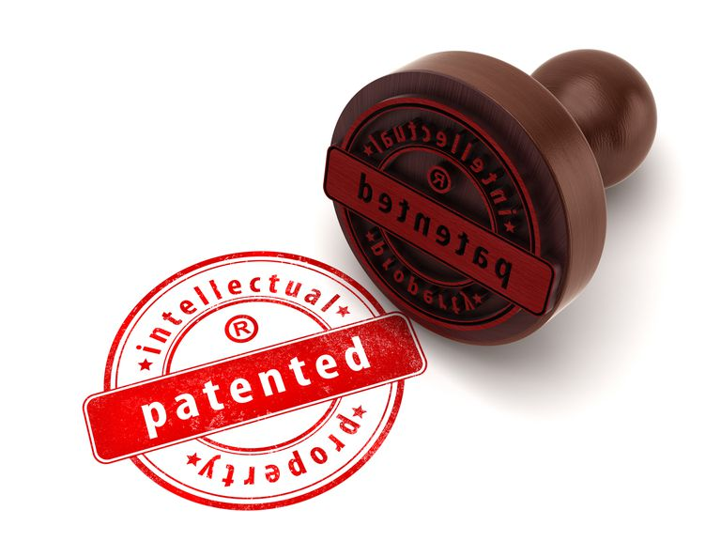
Access to IP Systems of Protection
Access to IP systems of protection:
© https://www.thoughtco.com/guide-to-patent-rights-and-ownership-1992248
Which office (in case) should be referred to to obtain IP protection?
What are the steps to be taken to obtain IP protection?
Who should advise SMEs on IP systems of protection?

Slide 11
Access to IP Systems of Protection
Access to IP systems of protection:
What are the exact criteria needed to obtain IP protection and how are they to be intended in practice?
Patents (patentable subject matter, new, inventive step, industrial applicability, disclosure);
Trademarks (new, distinguishing, not contrary to morality and public order);
…

Slide 12
Access to IP Systems of Protection
Access to IP systems of protection:
What are the exact criteria needed to obtain IP protection and how are they to be intended in practice?
…
Industrial designs (new and original);
Copyright (original and expression of an idea).

Slide 13

Access to IP Systems of Protection
Access to IP systems of protection - Practical questions/problems such as:
How to draft a patent application?
    © http://eracreditservices.com/2017/06/credit-repair-companies/
What can I protect as a trademark?
How to develop a distinguishing trademark?
How to develop an original industrial design?

Slide 14


Time & Costs of IP Protection
Time and costs of IP systems of protection:
© https://citynews.com.ng/how-to-know-what-your-time-is-worth-stop-wasting-it/ © https://www.vinsight.net/app-features/setting-standard-cost-simplified
Lack of clear understanding of the time necessary to obtain IP protection;
Lack of clear understanding of the advantages disadvantages of time needed (strong v. weak title; marketability of the product; etc.)
Lack of clear understanding of the costs IP protection entails;
Lack of clear costs/benefits analysis of IP protection.

Slide 15
Appropriate Timing of IP Protection
Timing and Terms of IP Protection and Ownership:
Ineffective IP protection and management due to timing (when is the right moment to protect?)
Disclosure of inventions (Dos and Don’ts);
Joint development of IP without clear terms (caution!).

Slide 16
IP Management
Lack of effective management and exploitation of IP rights:
Lack of understanding of the market (market analysis and study);
Lack of clear IP production plan (chain of production);
Lack of understanding of IP-exploitation tools (licensing, franchising and merchandising).

Slide 17
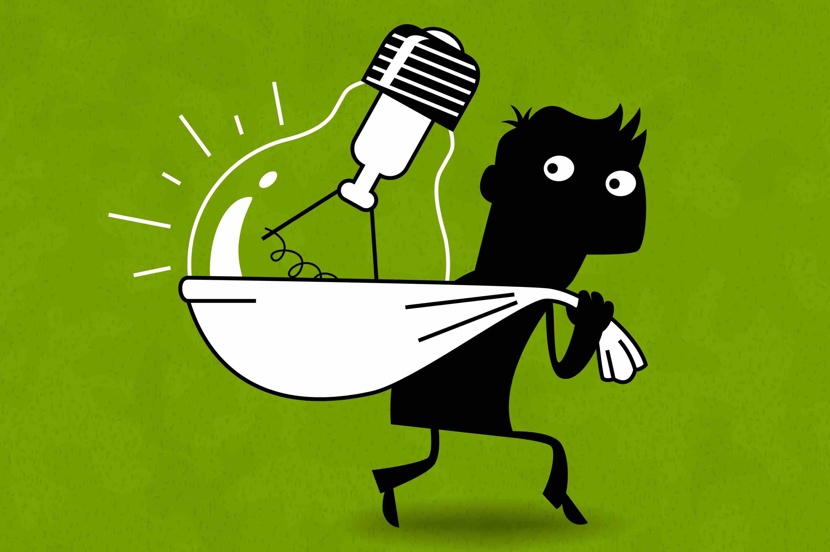
IP Enforcement
Enforcement of IP rights:
© http://businessadvice.co.uk/finance/get-funded/the-sole-traders-three-step-guide-to-intellectual-property-protection/
Lack of understanding: each company is its own policeman!
Lack of knowledge of enforcement mechanisms and remedies:
  E.g. civil and administrative sanctions; criminal sanctions, etc.
  E.g. destruction of infringing goods; pecuniary fines and detention, damages, etc.
Lack of knowledge of the right procedure to follow!

Slide 18
Some possible solutions
Bring clarity on the subject!
Make it clear that it does not take that much time…
…and, in any case, it is worth it!

Slide 19
Some possible solutions – In Practice!
Dissemination of information on IP through business associations and chambers of commerce;
Development of free-of-charge training courses, workshops, seminars and conferences on the subject;
Elaboration of documents and webpages on well-known successful case-studies.

Slide 20
Thank you for your attention!
Gabriele Gagliani
gabriele.gagliani@unibocconi.it

