Slide 1


WORLD INTELLECTUAL PROPERTY ORGANIZATION
Sub-Regional Workshop on Policy Mechanism for Supporting Small and Medium-sized Enterprises Use the Intellectual Property System in their Competitive Strategy
Beirut, Lebanon, March 27th and 28th, 2018
The Role of Intellectual Property (IP) in the Competitive Strategy of a Small and Medium-sized Enterprise (SME)
Arvind Viswanathan

Slide 2
Strategy
Business & Competition

Slide 3

What is Strategy?
"...broad formula for how a business is going to compete, what its goals should be, and what policies will be needed to carry out those goals“†
†: Porter, Michael E. (1980). Competitive Strategy. Free Press

Slide 4

Competitive Strategy
Defined as the long term plan of a particular company in order to gain competitive advantage over its competitors
Aimed at creating defensive position in an industry and generating a superior ROI

Slide 5


Nature of Competition
New types of competition emerges from the new:
Commodity
Technology
Source of supply
Type of organization
This is competition that “strikes not at the margins of the profits and the outputs of the existing firms but at their foundations and their very lives. This kind of competition is as much more effective than the other,” he argued, because the “ever-present threat” of dynamic, disruptive change “disciplines before it attacks.”
Capitalism, Socialism and Democracy. Joseph Schumpeter. 1942

Slide 6
Principles Underlining Strategy
3 essential points to consider‡:
creating a UNIQUE AND VALUABLE position,
making trade-offs by choosing "what not to do", and
aligning activities to support the chosen strategy
‡: Porter, Michael E. (1996). "What is Strategy?". Harvard Business Review 1996

Slide 7



Achieving Uniqueness
Creation of Knowledge
Innovate to Differentiate
Communication of Differentiation & Innovative Ability
  Ensure the Differentiation is Attributed to Self

Slide 8

Knowledge Economy
Knowledge is Weightless
Factors of production
  Land
  Labor
  Capital
  Intangibles (Knowledge)- Key difference from the past economies
Thus, Knowledge becomes the Property
  Owned
  Traded
KNOWLEDGE
underpins
PERFORMANCE

Slide 9
Nature of Competitiveness in Current Economy
In a knowledge-based economy, competitiveness of enterprises is increasingly based on ability to provide high-value-added products at a competitive price
Globalization and trade liberalization has made it crucial for most enterprises to become internationally competitive even when operating wholly in the domestic market
Especially for SMEs

Slide 10
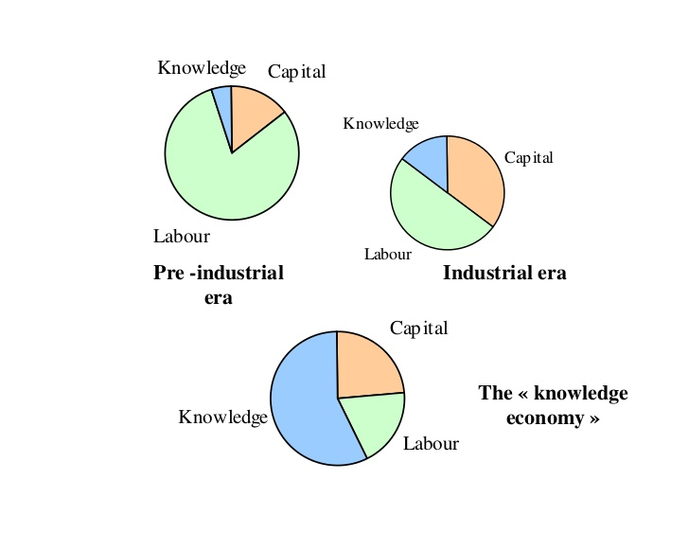
Distribution of Assets Through the Eras
https://image.slidesharecdn.com/theimportanceofintellectualpropertyipcompatibility-121009092245-phpapp02/95/the-importance-of-intellectual-property-ip-compatibility-4-728.jpg?cb=1349774602

Slide 11

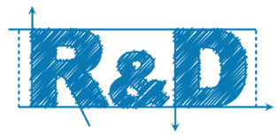
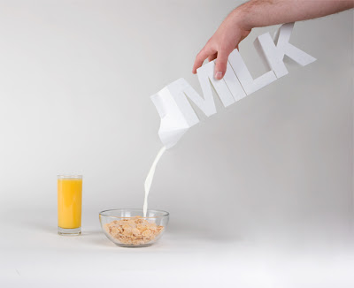
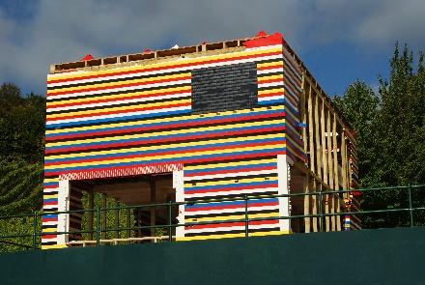
Becoming & Maintaining Competitiveness
Necessary to have a STRATEGY that ensures SMEs constantly:
  improve efficiency of operations
  reduce costs and
  enhance reputation of products
Can be achieved by addressing one or more of:
  Investing in research and development
  Acquiring new technology
  Improving management practices
  Developing creative and appealing designs
  Effectively marketing their products

Slide 12
Achieving Competitiveness
Significant investments of time and resources
Strong intellectual property protection
  Without it, strong possibility of developments being stolen/copied
Intellectual property rights enable exclusivity over the exploitation of the innovation
  New/original products
  Creative designs
  Marketing materials
  Brands

Slide 13
Securing Assets
Understanding & Identification

Slide 14
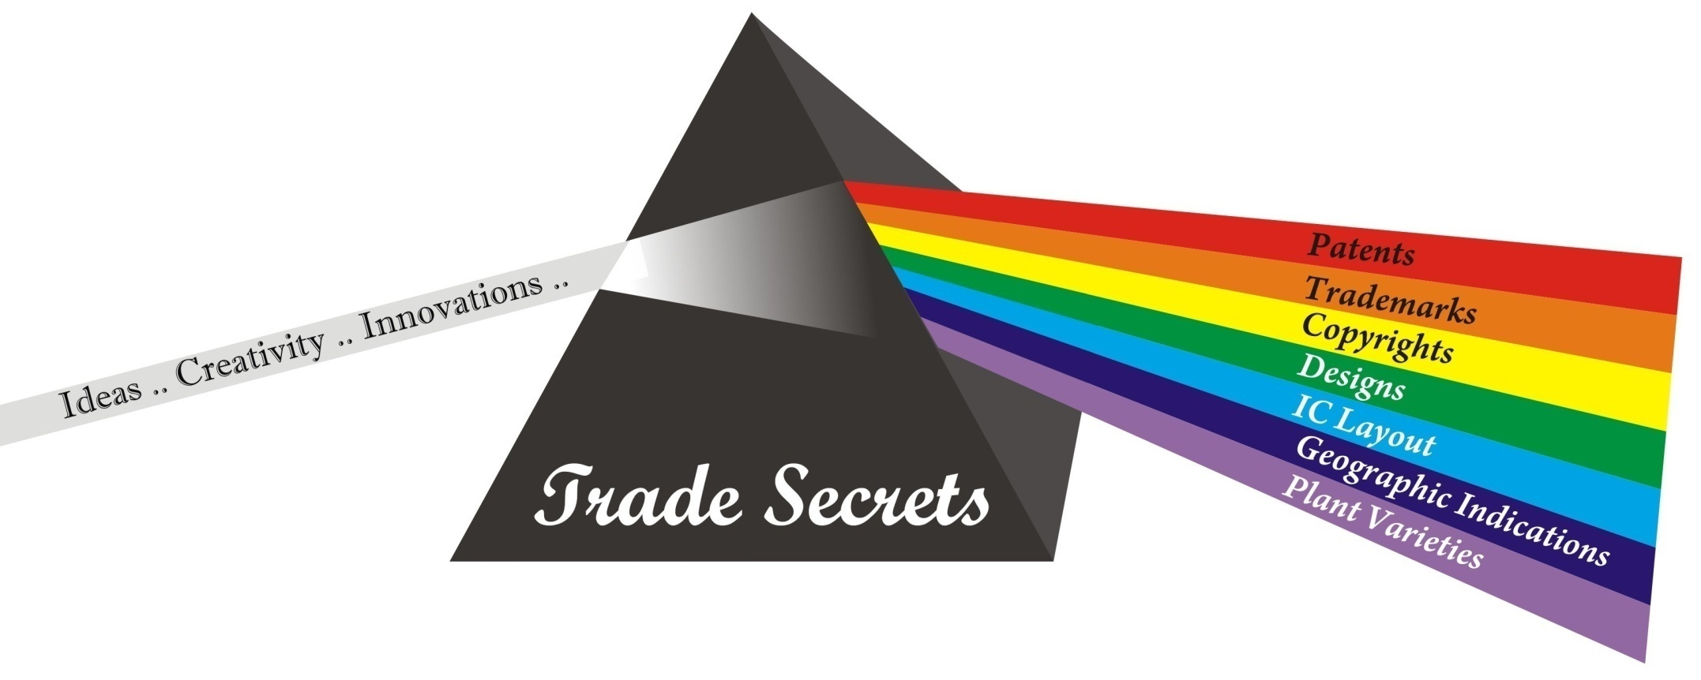
IPRism™

Slide 15
©opyrights
Copyrights apply to every production of the human spirit be it written, pictorial, sculptural, manuscript or oral, regardless of its value, importance or purpose and the mode or form of its expression
Law applicable to, among other works:
books, archives, pamphlets, publications, printed material and other literary, scientific and artistic writings;
lectures, addresses and other oral works;
audiovisual works and photographs;
musical compositions with or without words;
dramatic or dramatico-musical works;
choreographic works and pantomimes;
drawings, sculpture, engraving, ornamentation, weaving and lithography;
illustrations and drawings related to architecture;
computer programs whatever their language and including preliminary work;
maps, plans, sketches and three-dimensional works relative to geography, topography, architecture or science;
any kind of plastic art work whether intended for industry or not

Slide 16




T®ademarks™
Mark is any sign capable of being represented by a specific name or a form which is capable of distinguishing goods or services of one legal or natural person from those of other legal or natural person.
Mark may consist, inter alias, of one of the following signs or of any combination of such signs:
  Names of all kinds such as personal names, pseudonyms, words, expressions, letters, descriptions, numerals and emblems
  Forms such as drawings including protruding designs, stamps, figures, the shape of goods or their packaging, colors, combinations or degradations of colors, and three-dimensional signs
  Audio signs such as sounds and musical phrases taste and scents

Slide 17
Types of Trademarks
Collective Marks
A sign used to distinguish the goods or services produced by the members of a cooperative, association, or union
Certification Marks
Any mark used by a natural person or a legal entity with authorization from the proprietor of the mark and under his control, to indicate that the goods or services for which it is used are certified by the proprietor in respect of origin, quality, mode of manufacture, material, precision and other characteristics of the goods or services
Well-Known Marks
A mark which has become reputable in that section of the public concerned by the goods or services to which the mark applies

Slide 18

Geographic Indications
Geographical indication… [i]s used to describe a product originating in a region, specific place or country, and which possesses a specific quality, reputation or other characteristics attributable to that geographical origin and, and the production and/or processing and/or preparation of which take place in that defined geographical area.

Slide 19
Industrial Drawing or Design
Any pattern or configuration of lines or colors, and any shape or form whether connected to lines or colors or not, which may be used in an industry or handicraft trade, manually or mechanically, including textile designs, provided that such configuration or shape gives the industrial commodity or handicraft a special aspect
To register a design or drawing, it has to be NEW and has external features that give such drawing or design an INDIVIDUAL CHARACTER
NEW: if it has not been made available to the public in any manner whatsoever, or concretely used or published
INDIVIDUAL CHARACTER: if the overall
impression… [d]iffers from the overall impression produced by a drawing or design which has been made available to the public… [e]arlier

Slide 20
Patents
A patent shall be issued for each invention related to:
A new industrial product
new method that leads to the production of a new industrial product or a known industrial result
Every Novel application of a known industrial method or means
A new group of known methods or means
Final or intermediate topography of a semi conductor
Micro Organisms
Novel or discovered plant products provided that it complies with all the following conditions:
  Distinguished from all previously known varieties by a rarely changeable specific and important advantage; or by several advantages that collectively form a Novel plant variety
  Homogeneity of advantages
  Stability i.e. by the end of each production cycle it remains identical to its first definition

Slide 21

Trade Secrets
Some sort of information that:
  is not generally known to the relevant portion of the public
  is the subject of reasonable efforts to maintain its secrecy
  confers some sort of economic benefit on its holder
  may be used to obtain an advantage over competitors or customers
May be a
  formula
  practice
  process
  design
  instrument
  pattern
  compilation of information
A significant difference between trade secret and other forms of IP is that a trade secret is protected without disclosure of the secret

Slide 22
Time Periods for Different Forms of IP*
1 5 years
20 years
Patents
SICLD, Industrial Designs
&
Plant Varieties
50 y e a r s
F o r e v e r
Copyrights
Trademarks,
Trade Secrets & GIs
*: Maximum time. From the appropriate starting date & upon proper maintenance

Slide 23
Intellectual Property Questions
Can the innovation be legally protected? For how long?
How does one protect an innovation from imitators?
How much will it cost?
When to protect?
Etc…
The answers are generally quite complicated and usually requires the assistance of someone who specializes in this line of work

Slide 24


Strategy on My Mind
IP Strategy should be an integral part of the overall business strategy of an Enterprise
Ignore IP (yours’ & other’s) at your own peril!!!

Slide 25
Building an IP Strategy
Biz Strategy
Build Your Portfolio
  Strategic Protection
  Deploy Your Portfolio
  Design Freedom
  Manage Competition
  Enter new Markets
Deliver Revenue
Markets Development
Design Freedom
Manage Competition
Protecting Inventions/Recognition

Slide 26
Strategic IP Assets Protect Value
Value Comes From Use, Not Technical Sophistication
  IP Assets, like land, get their value from location
  Only valuable if they are coveted by others
Covetable assets come from important considerations:
Focusing on important market needs
  What will the market demand?
  Will technology become a standard?
  What are our competitive advantages?
Keeping an eye on the larger landscape
  What alternatives exist or will converge?
  Who are we likely to have IP disputes with: now and future?

Slide 27
Value Transference
  The premeditated use of multiple intellectual property regimes at specific points across the product lifecycle, in order to realize sustainable differentiation*
Using patents & designs early in the lifecycle to secure functional differentiations (at or near product launch)
  such as any new and useful technologies (utility patents)
  and/or unique ornamental attributes (design patents/industrial designs)
But focus of the functional differentiation is not sustainable
  Limited by lifeterm offered by the protection sought
Thus, building an association between protected aspects & a non-functional cognitive touch point is critical
  Design elements central to the cognitive touch point are then secured
    E.g. Shape, Color, Sound
Carefully orchestrated advertising builds the association in the consumer’s mind to complete the strategy
*: As defined by James Conley, Clinical Professor at both the Kellogg School of Management and the McCormick School of Engineering at Northwestern University
Copyright 2017
Arvind Viswanathan

Slide 28
Utilizing the Assets
Making IP work for you

Slide 29
Stages of New Product Development
3000 Raw Ideas = 1 Commercial Success
Raw Ideas
Ideas Submitted
Small Projects
Significant Developments
Major Developments
Launches
Commercial Success
3000
300
125
9
4
1.7
1
Greg Stevens and James Burley, 3,000 Raw Ideas = 1 Commercial Success, Research Technology Management, 40(3), May-June 1997, 16-27.

Slide 30
Requirements at Various Stages of Development
Marketing & Sales
Scale-ups, Designs, Trademarks, Manufacturing Facility
Patents, Designs,
Know-how, Prototypes, Market Testing, Regulatory Approvals
Patents, Trade secrets, Know-how
Trade secrets, Patents, Know-how, Business Plan
Trade secrets
Raw Ideas
Ideas Submitted
Small Projects
Significant Developments
Major Developments
Launches

Slide 31
Leapfrogging Stages
Risks greater at earlier stages; investments higher at later stages
Risk mitigation strategies include outsourcing some parts of the development
Ironclad agreements to be put in place

Slide 32
Assets Valorisation
Selling of assets: one time transaction for an agreed upon value
License: Permission given to a 3rd party for monetary consideration that extends for the duration of the lifetime of the assets
  Exclusive license: a single licensee has the right to use the technology
  Non-exclusive license: several licensees and the owner have the right to use
  Cross license: when several licensees agree to give access to each others’ technology
Copyright 2016
Arvind Viswanathan
32

Slide 33


Exclusivity & Control
A registered IPR allows the proprietor to prevent unauthorized usage
  Selling
  Using
  Offering for sale
  Import
Thus, proprietor has control in negotiations
As opposed to transferring knowledge through a series of documents
very tedious & inefficient
prone to misinterpretations
Copyright 2016
Arvind Viswanathan
33

Slide 34
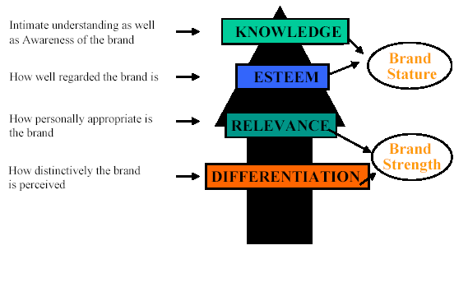
How a Brand is Built
Source: Association of Professional Design Firms, APDF, http://www.apdf.org/Public/Index.asp?Page_ID=74
34

Slide 35
Case Studies
Some Exemplary Companies & Their Long Term Vision & Execution

Slide 36
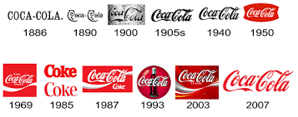
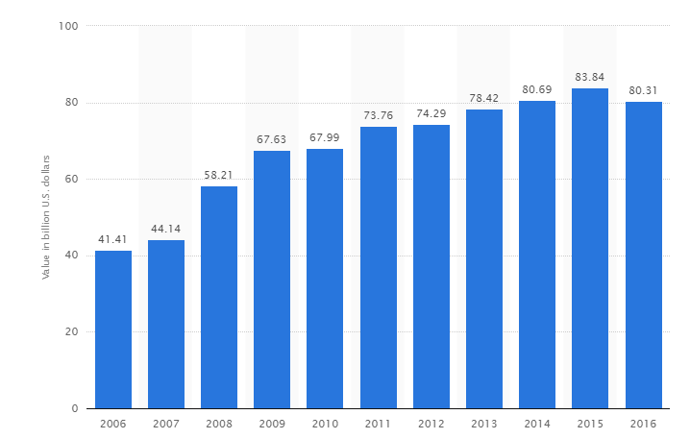
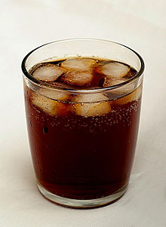

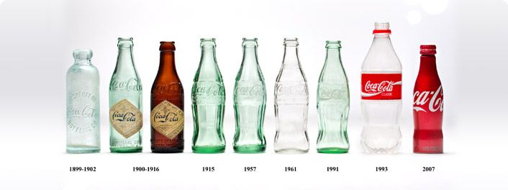
Various IPRs coming together for Coca Cola
A Quick Glimpse
Trademarks over the years
Coca-Cola's brand value from 2006 to 2016 (in billion U.S. dollars)
1000s of patents on processes, compositions, detection methods, vending machines operations and more…
Original recipe still maintained as a Trade Secret
Kept in a bank in Atlanta
Legends abound about those who know the secrets
https://www.statista.com/statistics/326065/coca-cola-brand-value/
Iconic Designs of bottles
36

Slide 37
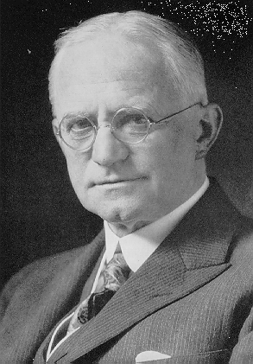
“You press the button, we do the rest†”
Developed and patented a dry photographic plate in 1880
In 1884, patented a photographic medium
  Both in England and U.S.A
Patented roll film camera in 1888
Filed key patents in all important facets
Then, focused the company to making film when competition heated in the camera industry
  By providing quality and affortable film to every camera manufacturer, Kodak managed to turn all competition into more business
George Eastman
† Marketing phrase coined for the film roll camera created by Geaorge Eastman
Copyright 2017
Arvind Viswanathan

Slide 38
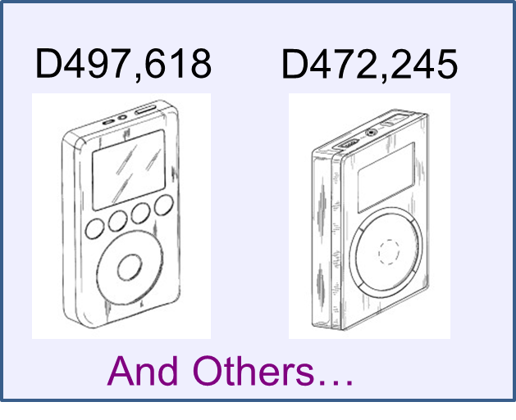
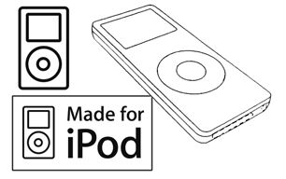
Clarity of Apple’s iPod® Strategy
Crowded product & technology area
Sourced in components
Focused on look, feel & use aspects
Great Design
Identified Critical Design Elements
Secured Legal Protection
Leveraged the monopoly offered
Built an excellent Brand Identity
Year-wise Growth in Market Share in Units Sold*
2004 | 56%
2005 | 72%
2006 | 72%
2007 | 70%
Trademarks
*: Source: http://apple20.blogs.fortune.cnn.com/2008/01/29/beyond-the-incredible-shrinking-ipod-market/
Copyright 2017
Arvind Viswanathan

Slide 39
“Brand” Companies
Nike...
Adidas...
Reebok...
Levi-Strauss…
…Own No Factories
39

Slide 40
Territorial Nature of IPR
Toyota Loses Trademark Battle over Prius at Indian Supreme Court
Toyota Jidosha Kabushiki Kaisha vs M/S Prius Auto Industries Limited on 14 December, 2017
"PRIUS" - a hybrid car that was popular in many countries
  Launched in 1997 in Japan initially, followed by many other countries
Toyota owned the TM which was filed in many countries
  Earliest filing in 1990 in JP
  First filing in India in 2009, when the car was launched
Prius Auto Industries, India are auto components manufacturers
They filed for a TM in India in 2002 for "PRIUS“
Supreme court adjudged that back in 2002 when Defendants filed for the TM, it wasn’t very well known in India even though it had a reasonable market in some countries
  " TMs are TERRITORIAL and hence, Well-Known is also Territorial "
Also Plaintiff’s delay in claiming ownership worked against them

Slide 41
Case Study: FBI Arrests Man Selling Software Debug Code
HINDUSTAN TIMES, New Delhi, August 28, 2002
US Software Giant, SOLID Works, engaged Geometric Software Solutions Limited (GSSL) for debugging source Code of “Solid Works 2001 Plus”
GSSL had signed Confidentiality Agreement
Shekhar Verma Left GSSL in June 2002; took copy of source code
Attempted setting up own company with the code
Was arrested on August 25 at Ashok Hotel
41

Slide 42
Brand Values
Global Brand Scoreboard & Their Respective Value- 2015
Rank | Organization | Estimated Brand Value, $ billion
1 | Apple | 184.2
2 | Google | 141.7
3 | Microsoft | 80
4 | Coca-Cola | 69.7
5 | Amazon | 64.8
http://interbrand.com/best-brands/best-global-brands/2017/ranking/#?filter=&listFormat=ls
Notes:
This gives an idea of how trademarks can become valuable business assets and why it is important to protect them.

Slide 43
“If you think it, Protect it”
“Because if it is worth copying, it is worth protecting”

